Slide 1

CREATE AI AGENTS CHAMPIONSHIP · DUBAI · PROJECT PITCH
Sirb.Ai
The missing-person search swarm. One accepted report wakes a fleet of coordinated agents that profile, sweep and track — until the person is verified found.
✓
Instant profile
▶
City-wide sweep
✓
Verified found
The clock starts the moment a family calls. We make the first hours count.
PRESENTED BY
Ravi Kumar D
December 2026
SEARCH SURFACES
Command room · CCTV grid · Hospitals & shelters
Notes:
• Greet the judges, introduce yourself and the project name — Sirb.Ai.
• One-line definition: a search swarm that turns one accepted report into a coordinated city-wide response.
• Preview the three chips: instant profile, city-wide sweep, verified found.
• Tone-setter: the clock starts when a family calls — this pitch is about making the first hours count.

Slide 2

Why This Case — and Why an Agent
Two realities shape every missing-person search in a city of 200 nationalities.
◔
◉
The odds decay by the hour.
Dubai has the eyes. Not the hands.
In the grimmest abduction studies, three of four children are harmed within three hours. A search that moves phone-call by phone-call loses those hours to logistics instead of leads.
Oyoon watches the city's cameras and CAD dispatches patrols — yet the amber protocol itself is stitched together by hand, one call and one appeal at a time. The missing piece is orchestration, not awareness.
✓
OFFICIAL EVIDENCE BASE
76%
of abducted-murdered children are harmed within 3 hours (WA State AG)
NamUs — U.S. Department of Justice national missing-persons system · namus.nij.ojp.gov
WA State Attorney General — abduction-homicide timeline study
Alzheimer's Association — the 24-hour wandering rule · alz.org
600K
missing-person records entered yearly in the U.S. alone (NamUs)
1 in 2
wandering dementia patients not found within 24 hours suffer grave harm (Alzheimer's Assn)
♥
Behind every statistic is a family refreshing their phone.
Notes:
• State both truths plainly: the odds decay by the hour, and Dubai has the eyes but not the hands.
• Name the three sources: NamUs (U.S. Department of Justice), the WA State Attorney General abduction-homicide timeline study, and the Alzheimer's Association 24-hour wandering rule.
• Point to the rail stats: 76% harmed within 3 hours, 600K records yearly, 1 in 2 wandering patients.
• Land the footer line slowly — behind every statistic is a family refreshing their phone.

Slide 3

Prerequisites — Nothing New to Buy
⊕
Sirb orchestrates systems Dubai Police runs today — no new hardware, no new procurement — and an officer approves every consequential step.
Computer-aided dispatch (CAD)
★
01
An accepted report wakes the swarm instantly; no console left idle.
Oyoon CCTV grid
▶
02
Cameras along the predicted route task themselves; no operator scrolls feeds.
Police media & city channels
◖
03
Appeals versioned for press, SMS and socials in minutes, in any language.
Hospitals, shelters & embassies
✚
04
Welfare sweeps fire in parallel; every reply is logged against the case.
OPERATING PRINCIPLES
▶
One accepted report — every search surface moves together.
✓
Officer in command
✓
Reported persons only
✓
Every action audited
✓
Family kept informed
Notes:
• Emphasise zero-procurement: Sirb orchestrates systems Dubai Police already runs — no new hardware, no new procurement.
• Walk the four systems: CAD wakes the swarm, Oyoon cameras task themselves along the predicted route, police media versions appeals in minutes, hospitals and shelters sweep in parallel.
• Note the officer gate: an officer approves every consequential step.
• Close with the four operating principles: officer in command, reported persons only, every action audited, family kept informed.

Slide 4
Our Use Case — One Agent, Two Protocols
A missing child and a missing colleague must never run the same playbook. Sirb grades every report and picks the speed.
PATH A · HIGH-RISK
PATH B · STANDARD
THE FIRST SIX HOURS
0 min
1
Grade — age, health flags and risk indicators set the clock in seconds
1
Verify — identity and circumstances confirmed from the report
report accepted
15 min
2
Alert — amber broadcast on media, SMS and city screens inside minutes
2
Probe — hospitals, transit hubs and known addresses checked quietly first
amber broadcast live
90 min
3
Swarm — CCTV, hospitals, shelters and transit sweep in parallel
3
Update — one multilingual family channel, no conflicting calls
full city sweep running
6 hrs
4
Fuse — leads deduplicated, scored and pushed to patrols on a live map
4
Close — only on confirmed contact and an officer's sign-off
every lead resolved or escalated
Fast when it's life and death. Thorough when it's not.
⚡
High risk gets the full swarm. Routine gets relentless follow-through. Families get certainty either way.
Notes:
• Contrast the two clocks: a missing child and a missing colleague must never run the same playbook — Sirb grades every report.
• Walk Path A's four verbs briskly: grade, alert, swarm, fuse.
• Walk Path B's four calmly: verify, probe, update, close.
• Point at the six-hour ruler: 0 min accepted, 15 min broadcast, 90 min sweep, 6 hrs resolved or escalated.
• Close on the footer line: full swarm for high risk, relentless follow-through for routine, certainty for families.

Slide 5
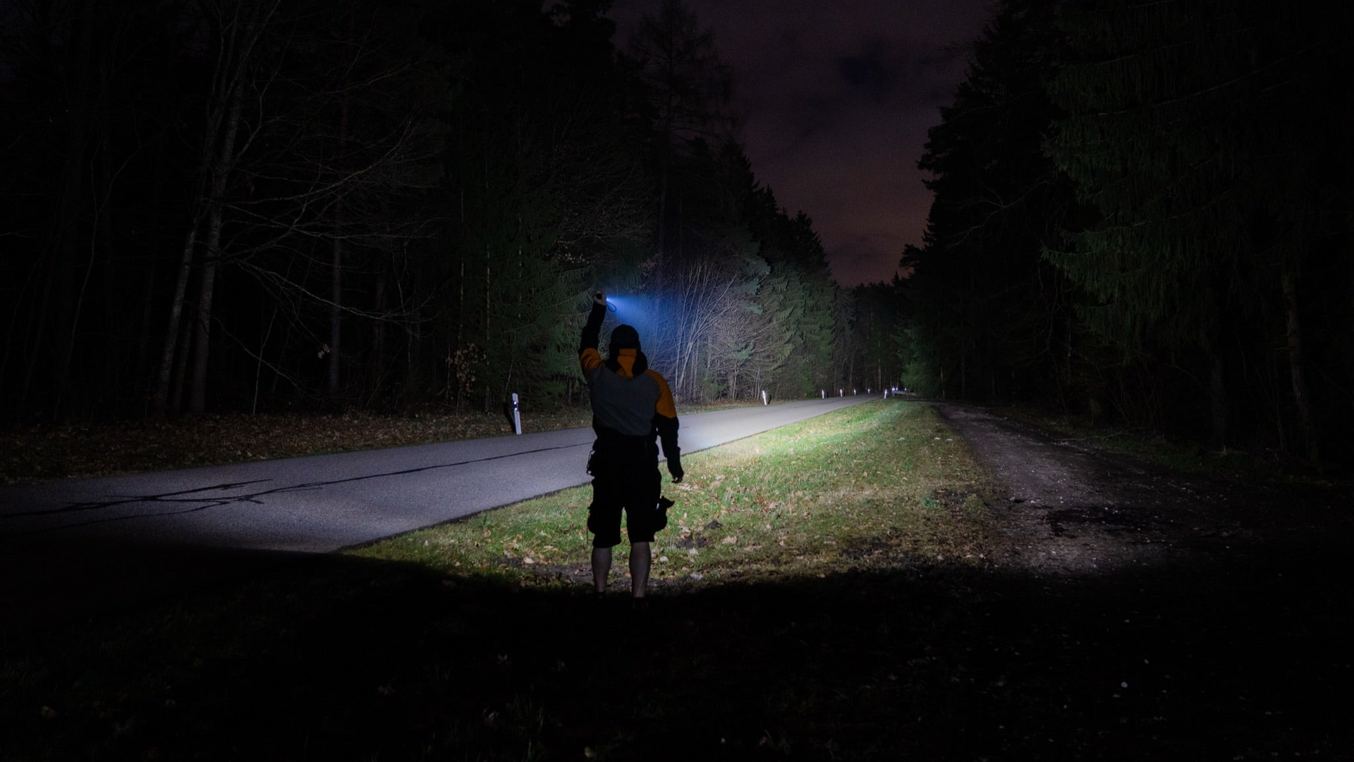

♥
WHY THIS MATTERS
Someone is out there.
The city sleeps. The search can’t.
For a family, this is never case 2026-114. It is a name, a photo on a lock screen, a bed nobody touched. Dubai Police answers with skill and compassion — but the coordination still travels one phone call at a time, while the trail cools in the dark.
Dubai’s AI already has eyes that watch. Sirb gives it agents that act.
Notes:
- Pause before speaking — let the image breathe and the room settle.
- Read the headline aloud, slowly, line by line: "Someone is out there. The city sleeps. The search can't."
- Body: for the family it is never a case number — a name, a photo on a lock screen, a bed nobody touched — yet coordination still travels one phone call at a time while the trail cools.
- Deliver the gold line as the thesis of the whole pitch: Dubai's AI has eyes that watch — Sirb gives it agents that act.

Slide 6
Inside Sirb — The Eight-Step Swarm Loop
1
Trigger
2
Profile
3
Grade
4
Gate
CAD accepts the report; the swarm spins up with the case file attached.
Photo, last seen, routes, habits, vehicle and health notes fused into one live case card.
A transparent risk score picks the protocol: amber, quiet or watch.
Authority and privacy checks pass before any broadcast or data pull fires.
5
Fan-out
6
Fuse
7
Act
8
Audit
Five sub-agents run at once — media, CCTV, hospitals, shelters, transit.
Sightings stream back deduplicated, scored and plotted on one live map.
A verified sighting routes the nearest patrol; hour six escalates to detectives.
Every action logged — what ran, who approved, what it changed.
▶
Route intelligence — CCTV follows the predicted route, not the map grid
⚡
Deterministic amber — life-safety alerts never queue behind an LLM
✓
Lead ledger — open → graded → tasked → confirmed → closed
Eight steps exist for one reason: no hour of the six is lost to coordination.
Notes:
- Walk the loop 1→8 with one short sentence per step; keep the rhythm brisk.
- Stress step 4, Gate: authority and privacy checks pass before any broadcast or data pull fires.
- Stress step 7, Act: a verified sighting routes the nearest patrol, and hour six escalates to detectives.
- Touch the three chips: route intelligence, deterministic amber (life-safety alerts never queue behind an LLM), and the lead ledger.
- Land the footer line: eight steps exist so no hour of the six is lost to coordination.

Slide 7
Accuracy & Performance — Targets, Not Promises
Every figure is a prototype acceptance test, scored per scenario in rehearsal drills with recorded live-data replays.
⚡
< 15 min
♪
≥ 95%
✓
0
Report-to-broadcast target
Surfaces reached in window
Leads lost between agents
accepted report to city-wide amber appeal
media, CCTV, hospitals, shelters — on time
every tip logged and tracked to closure
⛨
100%
⇄
10+
◔
6 hrs
High-risk get full protocol
Languages on standby
End-to-end coverage
child, dementia and abduction cases never wait
appeals versioned for Dubai’s 200 nationalities
first call to verified resolution or detective handoff
ⓘ
The prototype runs on simulated camera feeds and published data — live integration rides Dubai’s existing systems at pilot stage, never before.
Notes:
- Be candid upfront: these are targets, not promises — prototype acceptance thresholds, not marketing claims.
- Explain the method: every figure is scored per scenario in rehearsal drills with recorded live-data replays.
- Call out the bookends: under 15 minutes report-to-broadcast, and 6 hours end-to-end coverage; also 100% — child, dementia and abduction cases never wait.
- Deliver the footer line to pre-empt the feasibility question: simulated feeds and published data now; live integration rides Dubai's existing systems at pilot stage, never before.

Slide 8
↗
PROJECTED IMPACT
Six hours, covered end-to-end,
for every missing person in Dubai
Children who wander, elders with dementia and vulnerable adults are the categories Dubai answers by hand today. Sirb adds parallel reach, fused leads and a tracked trail from first call to verified reunion.
♛
9.0 / 10
— highest-rated of 300 agent use cases in our Dubai Police 2040 catalog
3 hrs
40%
8M
100%
the decisive window
of dementia patients will wander
children reported missing yearly
of leads closed by name
broadcast compressed from hours to minutes
Dubai's ageing residents included (Alzheimer's Assn)
worldwide (ICMEC) — global pain, local gap
logged, graded, tracked, signed off
ⓘ
Statistics cite the evidence base on slide 2; agent outcomes are pilot targets validated in live drills. Sirb complements officers, detectives and family liaison — it never replaces them.
Notes:
- Open with the headline claim: six hours covered end-to-end for every missing person in Dubai.
- Ground it with the four columns — the decisive 3-hour window, 40% dementia wandering, 8M children reported missing yearly, 100% of leads closed by name.
- Mention the 9.0/10 Dubai Police 2040 catalog rating as internal validation, not external proof.
- Deliver the footnote as a safeguard: Sirb complements officers, detectives and family liaison — it never replaces them.

Slide 9

Built on Guardrails — Dignity Before Speed
A search agent works inside a family's most fragile hours. Six commitments make it worthy of that trust.
Officers stay in command
Reported persons only
⛨
the swarm coordinates; detectives decide, verify and close
✦
no watchlists, no speculative sweeps — only formally accepted cases
Deterministic alerts
Case-scoped privacy
⚡
life-safety broadcasts run on fixed rules with human sign-off
⚿
data lives inside the case and purges automatically at closure
No false reassurance
Dignified appeals
⊘
the family channel shows verified status, never invented comfort
♟
vetted police channels only — never sensational, never a crowd manhunt
♥
Speed earns headlines. Trust earns adoption.
Notes:
- Frame the guardrails as the differentiator: dignity before speed.
- Walk the six commitments briefly — officer command, reported persons only, deterministic alerts, case-scoped privacy, no false reassurance, dignified appeals.
- Spotlight privacy: case data lives inside the case and purges automatically at closure.
- End on the caption: speed earns headlines, trust earns adoption.

Slide 10


One Report.
A Hundred Searchers.
Profile instantly
→
Sweep in parallel
→
Reunite verified
Sirb.Ai puts the six hours that decide everything on a single rail — one accepted report fans out across cameras, hospitals and airwaves, and every lead returns to a named officer, on the record, until the case closes the only way that matters: found.
Thank you — Ravi Kumar D
Create AI Agents Championship · Dubai · December 2026
The clock is already running. Give the first hours an agent.
Notes:
- Recap the three verbs: profile instantly, sweep in parallel, reunite verified.
- Restate the one-liner: one accepted report fans out across cameras, hospitals and airwaves; every lead returns to a named officer, on the record, until the case closes — found.
- Thank the jury: Create AI Agents Championship · Dubai · December 2026.
- End on the gold line: the clock is already running — give the first hours an agent.

